Slide 1
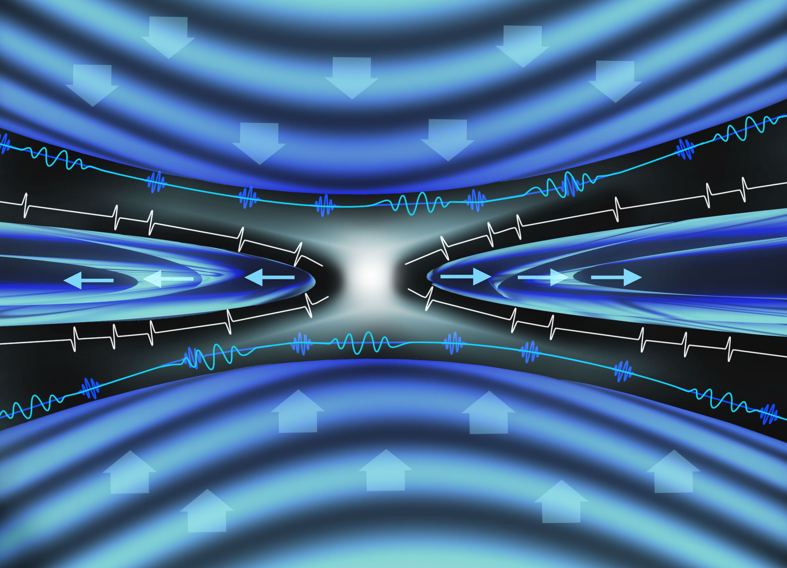

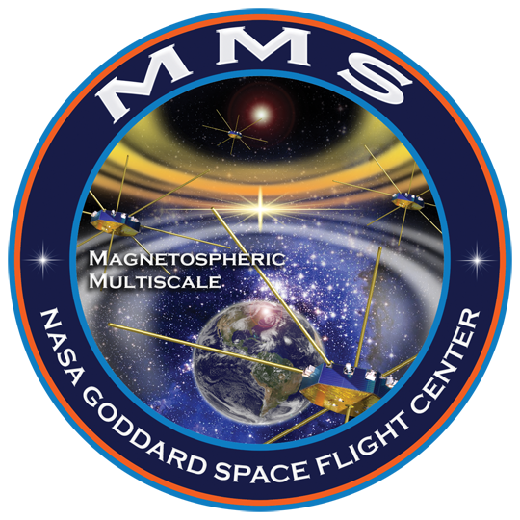
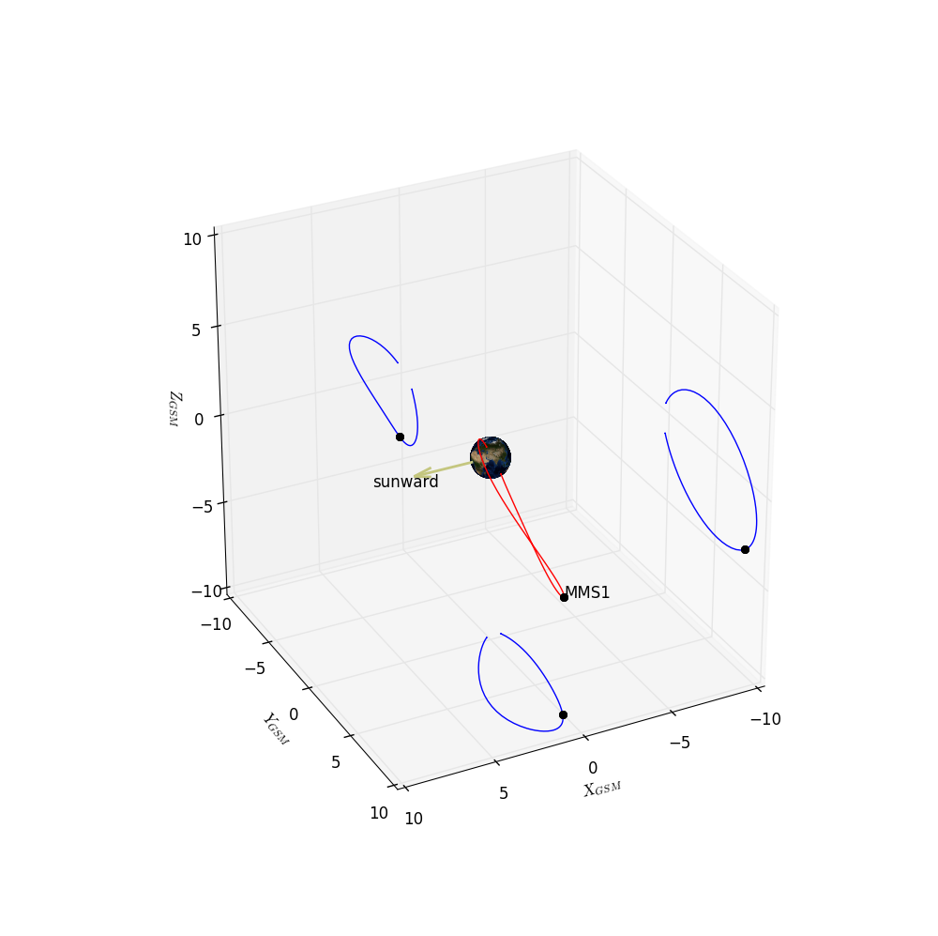
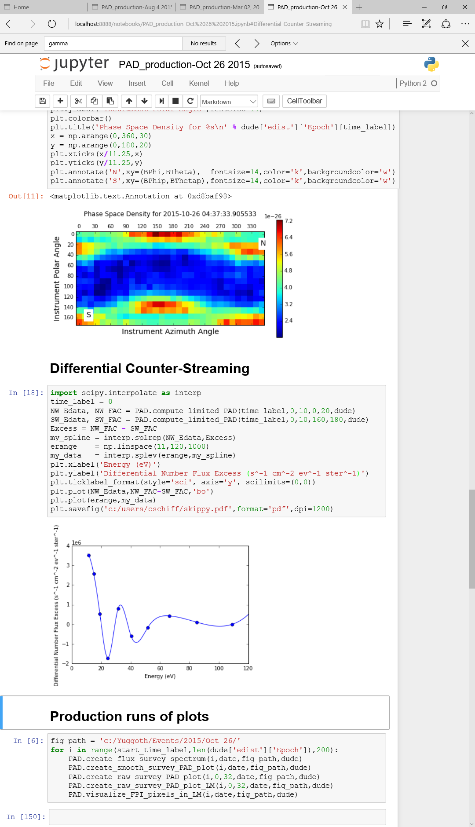
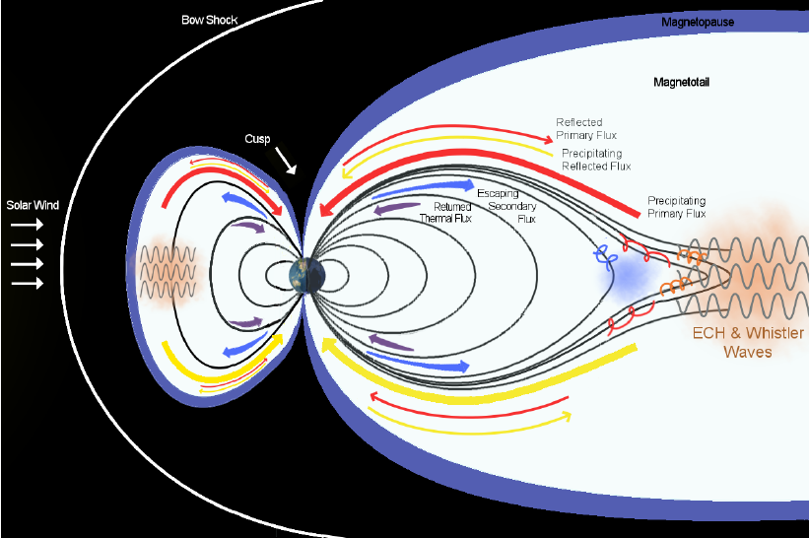
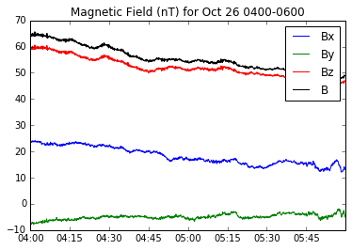
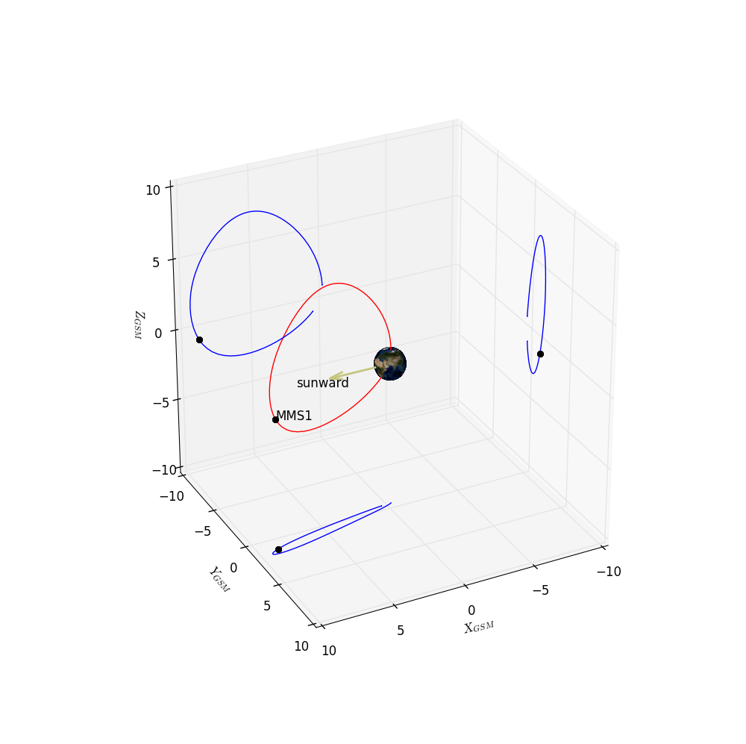
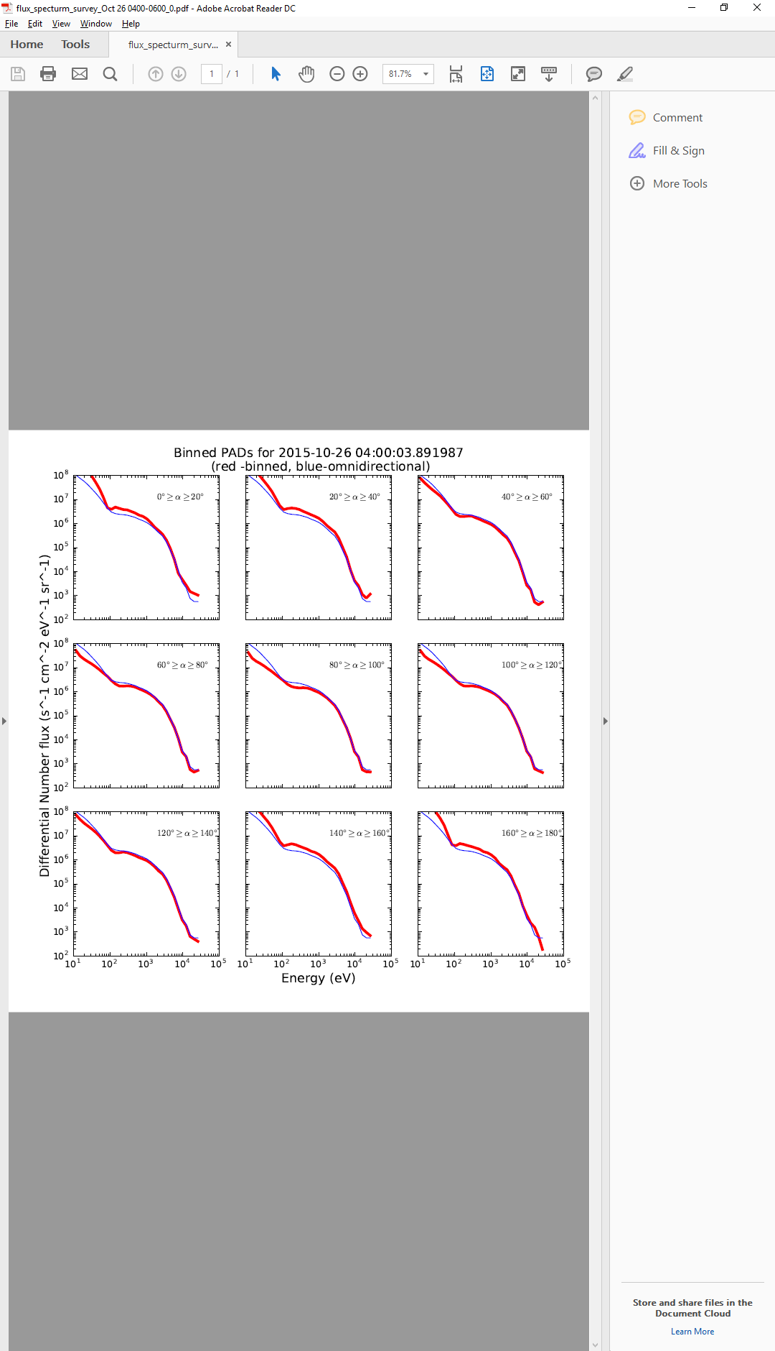
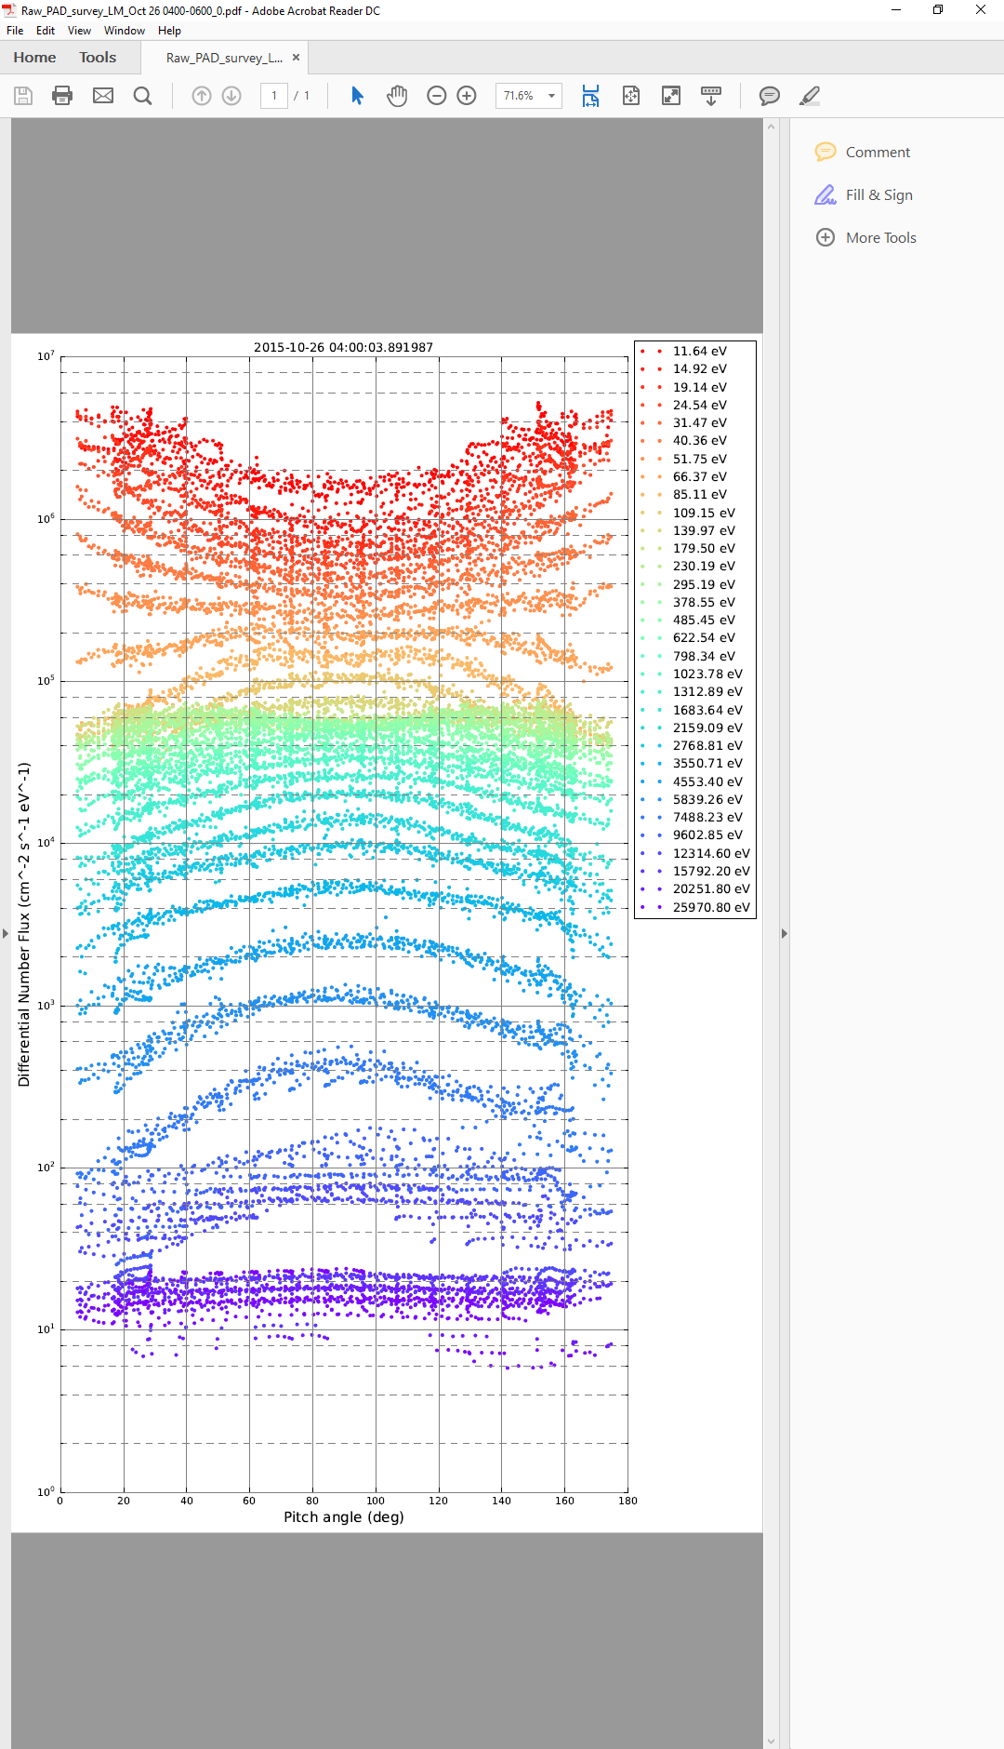
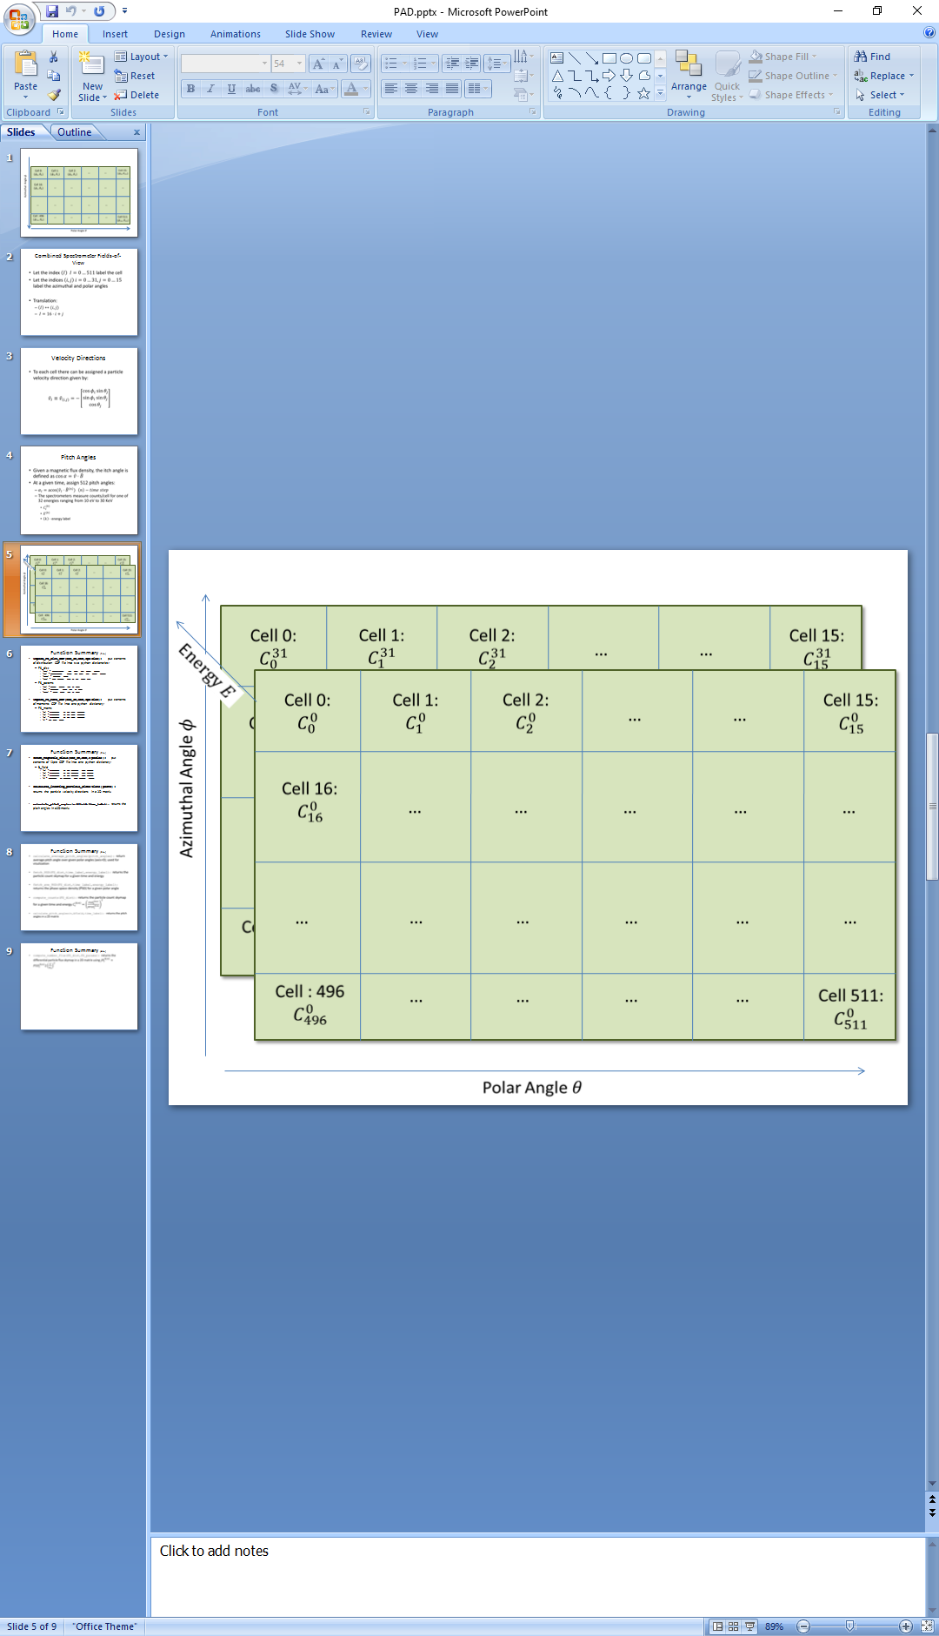
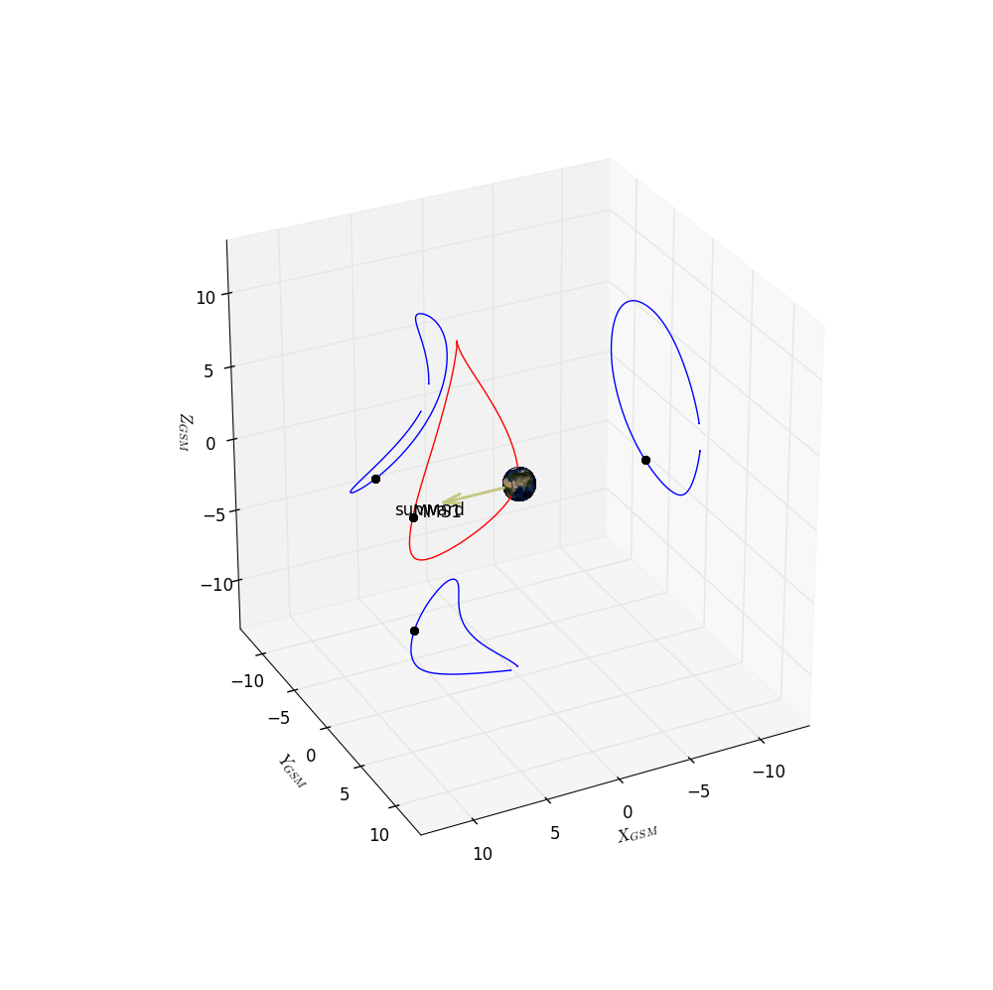
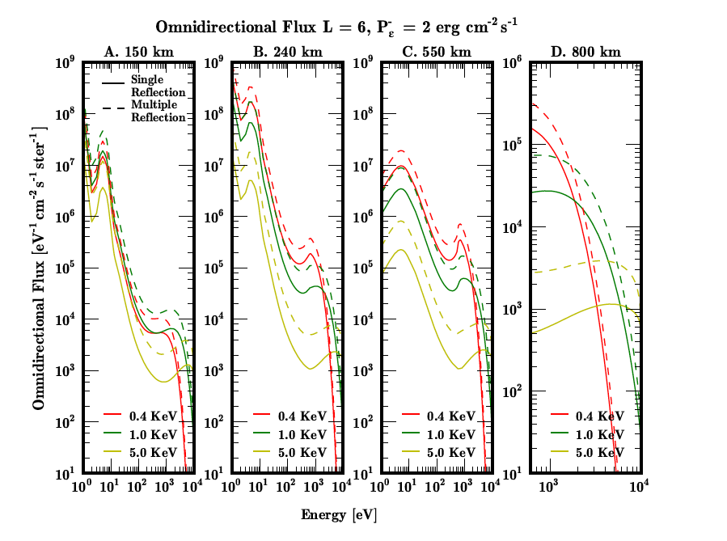
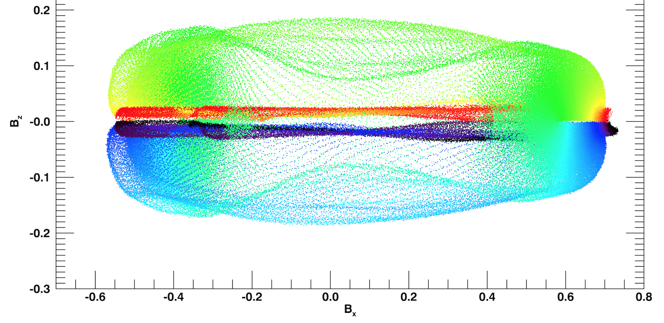
Differential Electron Flux Spectra Measured by the Magnetospheric Multiscale Mission Show Strong Field-aligned Electron Population of Ionospheric Origin
Conrad Schiff¹ (Conrad.Schiff-1@nasa.gov), George Khazanov¹, Barbara L. Giles¹, Levon A. Avanov^{1,2}, J.L. Burch³,V.N. Coffey⁴, J.C. Dorelli¹, D. Gershman^{1,2}, B. Lavraud⁵, T. E. Moore¹, W.R. Paterson¹, C.J. Pollock⁶,C.T.Russell⁷,Y. Saito⁸, J.-A. Sauvaud⁵,R.J. Strangeway⁷ |¹NASA Goddard Space Flight Center, Greenbelt, MD, ²University of Maryland, College Park, MD, ³Southwest Research Institute, San Antonio, TX, ⁴NASA Marshall Space Flight Center, Huntsville, AL, ⁵Research Institute in Astrophysics and Planetology, Toulouse, France, ⁶Denali Scientific, Healy, AK, ⁷University of California, Los Angeles, CA, ⁸Institute for Space and Astronautical Science, Sagamihara, Japan
????-????
Background
Results
Motivation and Context
Data Analysis Methodology
Aug 04, 2015 538
Wave particle interatcion How can magnetic reconnection occur in a collisionless plasma? This outstanding mystery in plasma physics fueled the successful launch of NASA’s Magnetospheric Multiscale (MMS) mission. The primary science goal of MMS is to reveal the small-scale, 3D structure and dynamics of the elusive electron diffusion region (EDR) believed to hold the key to the reconnection puzzle.
How can we infer a spacecraft’s trajectory through the geometry of magnetic reconnection? Answering this question is crucial for interpreting satellite observations of reconnection in Earth’s magnetosphere. Viewed from the frame of a reconnection X-line at the magnetopause, the spacecraft’s motion is often a complex, nonlinear path through the various reconnection regions. Approaching this problem quantitatively, we have developed an algorithm that takes as input two quantities measured by MMS and outputs a trajectory through particle-in-cell (PIC) simulations of magnetic reconnection along which the input measurements are matched [1].
Here, we apply our algorithm to study the recently reported magnetopause EDR crossing captured by MMS on 16 October 2015 [2, 3, 4]. We can assess the trajectory’s accuracy by quantifying errors between MMS and PIC data, and we compare simulation energy and pitcKhazanov, G. V., A. Glocer, and E. W. Himwich (2014), Magnetosphere-ionosphere energy interchange in the electron diffuse aurora, J. Geophys. Res. Space
Description points…
Reference to [Sonnerup1998]
Reference to [Hielata2015?]
Oct 26, 2015 0
Mar 02, 2016
Conclusions
Future Work
We find a ‘best-fit’ trajectory through the PIC domain that matches MMS B_{L} and U_{iL} data from the magnetopause EDR encounter on 16 October 2015.
Crescent-shaped electron distributions observed by MMS in the EDR are consistent with simulation distributions at the corresponding time along the computed trajectory.
Overall ‘normalized error’ of less than 10% based on seven quantities compared.
Apply algorithm to more MMS EDR events.
Compare more non-ideal quantities, such as:
J•E, J•(E+v_{e}×B), ∇•P_{e}, inertial terms, etc.
Extend methodology to 3D PIC simulations.
Explore PIC boundary condition dependence.
Include time dependence of PIC quantities.
PIC B_{L}-B_{N} Hodogram
References
Acknowledgements
[1] Shuster et al. (2016), Geo. Res. Lett., under review.
[2] Burch et al. (2016), Science, 352(6290), aaf2939.
[3] Torbert et al. (2016), Geo. Res. Lett., 43, 5918-5925.
[4] Denton et al. (2016), Geo. Res. Lett., 43, 5589-5596.
[5] Daughton et al. (2014), Phys. Plasmas., 21, 052307.
[6] Sonnerup and Scheible (1998), ISSI/ESA, SR-001.
[7] Hietala et al. (2015), Geo. Res. Lett., 42, 7239-7247.
[8] Chen et al. (2016), Geo. Res. Lett., 43, 2405-2412.
This research was supported in part by NSF grants AGS-1543598, AGS-1202537, an NESSF fellowship, and NASA grants to the Theory and Modeling Program, FIELDS team, and the Fast Plasma Investigation of the MMS mission.

